Slide 1
Probability and Statistics
Poisson

Slide 2
Binomial and Poisson
Like the binomial distribution, these numbers are whole numbers, and such a random variable is a discrete random variable.
Unlike the binomial distribution, it is an infinite random variable (e.g. There is no upper limit for the number of cars to pass under a bridge)
In the binomial distribution, we have np (i.e. N is number of times something happening) – this doesn’t exist in Poisson. Instead Poisson has to describe average (i.e. how many events we should expect in that interval)

Slide 3
Binomial and Poisson
In the binomial distribution, each “flip” was independent of the others.
In the Poisson distribution, an “occurrence” happening
at one time interval is independent of another occurrence happening at a different time interval.

Slide 4
The Poisson Experiment - Properties
Some of the properties for a Poisson experiment can be hard to identify.
Generally only have to consider whether:-
  The experiment is concerned with counting number of RARE events occur in a specified interval
  These RARE events occur randomly
  Intervals within which RARE event occurs are independent and do not overlap

Slide 5
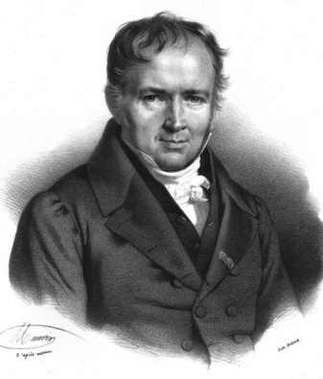
Poisson Process
Suppose we have a stochastic system in which events of interest occur independently with small and constant probability q – this is called Poisson Process
A Poisson Process is the stochastic process in which events occur continuously and independently of one another.
The name Poisson comes from the French mathematician
Sim´eon Denis Poisson (1781–1840).

Slide 6
ROLE OF Poisson DISTRIBUTION
It is used in quality control statistics to count the numbers of defects of any item
In biology to count the number of bacteria
In physics to count the number of particles emitted from a radio active substance
In insurance problems to count the number of casualities
In waiting time problems to count the number of incoming telephone number of incoming telephone calls or incoming customers
The number of typographical errors per page in typed material

Slide 7
Poisson Process
Examples:
The number of airline crashes next year
• The number of people arriving at a drive-through window in the next hour
The arrival of an email to your inbox
The number of lightbulbs removed from inventory today etc.
They are all in terms of “number” of a certain occurrence in a certain interval of time (or space).
They are all described by a random variable, in that there are many possible answers, and we don’t know which one it is.

Slide 8
Poisson Distribution
The Poisson process is a collection {X(t) : t > 0} of random variables, where X(t) is the number of events that have occurred up to time t (starting from time 0).
The number of events between time a and time b is given as X(b) - X(a) and has a Poisson distribution.

Slide 9
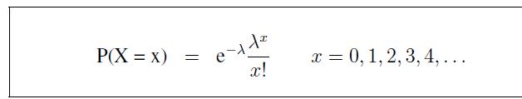
Poisson Distribution
The Poisson distribution is a discrete probability distribution for the counts of events that occur randomly in a given interval of time (or space).
If we let X = The number of events in a given interval
Then, if the mean number of events per interval is
The probability of observing x events in a given interval is given by

Slide 10

Poisson Distribution
e is a mathematical constant. Approximately equal to 2.71828
If the probabilities of X are distributed in this way, we write
is the parameter of the distribution.
We say X follows a Poisson distribution with parameter
A Poisson random variable can take on any positive integer value

Slide 11

Example 1
Births in a hospital occur randomly at an average rate of 1.8 births per hour. What is the probability of observing 4 births in a given hour at the hospital?
Let X = No. of births in a given hour
(i) Events occur randomly
(ii) Mean rate = 1.8
X ~Po(1.8)

Slide 12
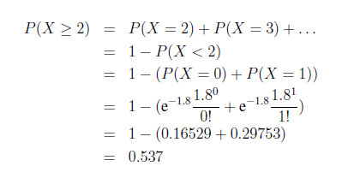
Example 2
What about the probability of observing more than or equal to 2 births in a given hour at the hospital?
We want P(X ≥ 2) = P(X = 2) + P(X = 3) +... Infinite number!!!

Slide 13

Example 3
Cars enter Sepang Circuit at the average rate of
20 per minute. What is the probability that in the next minute, we will have 10 cars entering the Sepang Circuit?

Slide 14
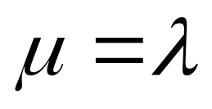
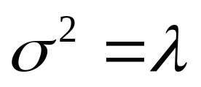
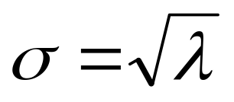
Poisson Mean and Variance
Mean
Variance
Standard Deviation
where λ = expected number of hits in a given time period

Slide 15

Changing time intervals
On average, a certain store has 0.2 shoplifting incidents per day. What is the probability that there are two shoplifting incidents in a 4-day period?
In this case, X is not an integer (average) and there are two time intervals !
If there are 0.2 incidents in one day on average, then there are (0.2)(4) incidents in four days, on average. Thus = (0.2)(4) = 0.8.
If X is the number of shoplifting incidents in the four-day interval, then

Slide 16
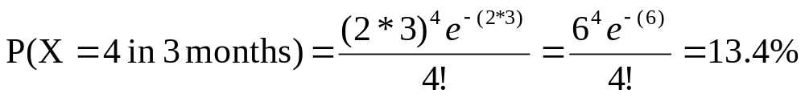
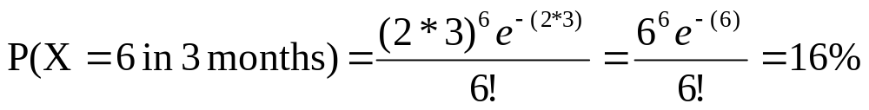
Changing time intervals
If new cases of West Nile in New England are occurring at a rate of about 2 per month, then what’s the probability that exactly 4 cases will occur in the next 3 months?
X ~ Poisson (λ=2/month)
Exactly 6 cases?

Slide 17
The End

